Slide 1
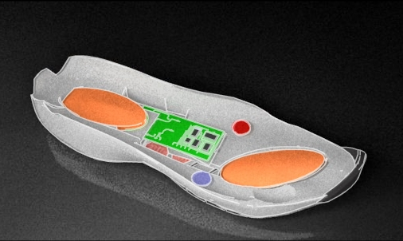
Bioe 494 - “ Smart Shoe”
Group 4 - Michael Hume, Anupriya Mathews, Luke Paltzer, Frehiwot Woldeyes

Slide 2
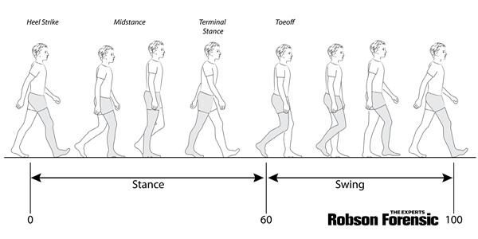
Biomechanical Background
Gait analysis is the systematic measurement, description, and assessment of quantities that characterize human motion; more simply put, it is the evaluation of a subject's walking pattern (Ovidsp.tx.ovid.com, 2019).
We will develop a wearable smart-shoe which will incorporate force sensors and accelerometers to analyze the users gait.
Analysis is mainly performed using force platforms used to measure ground reaction forces exerted on the muscles
Notes:
Presenter-Frita

Slide 3
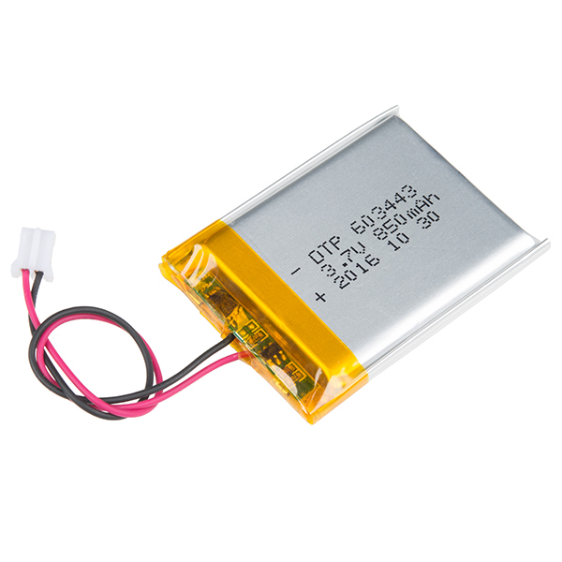
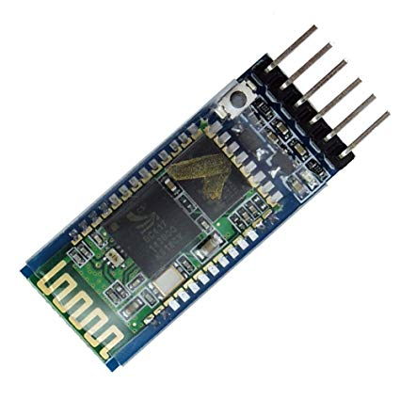
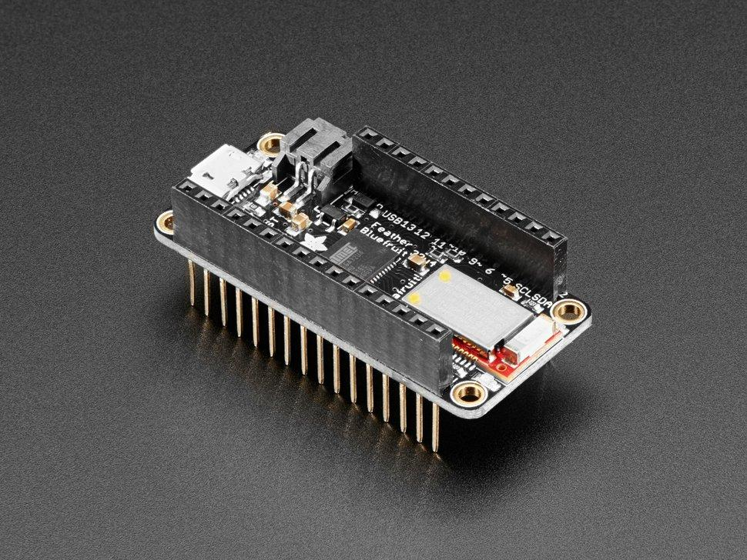
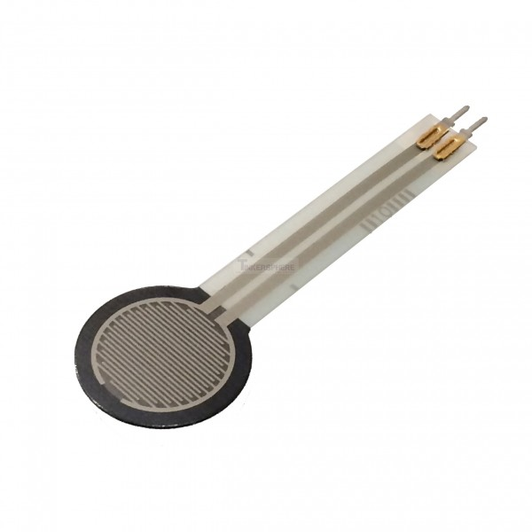
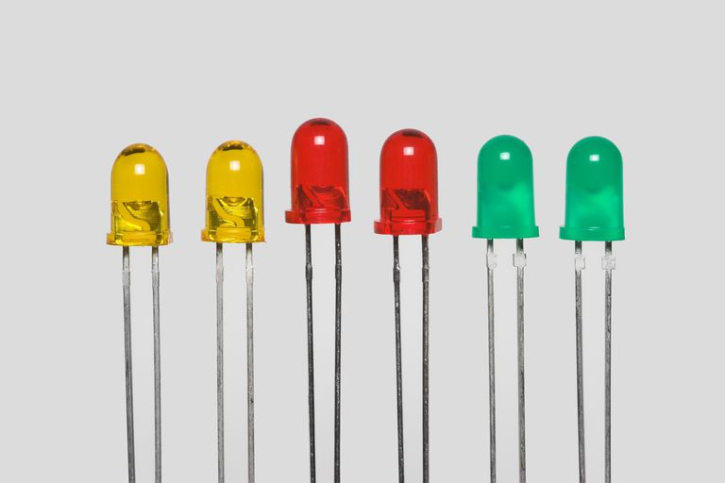
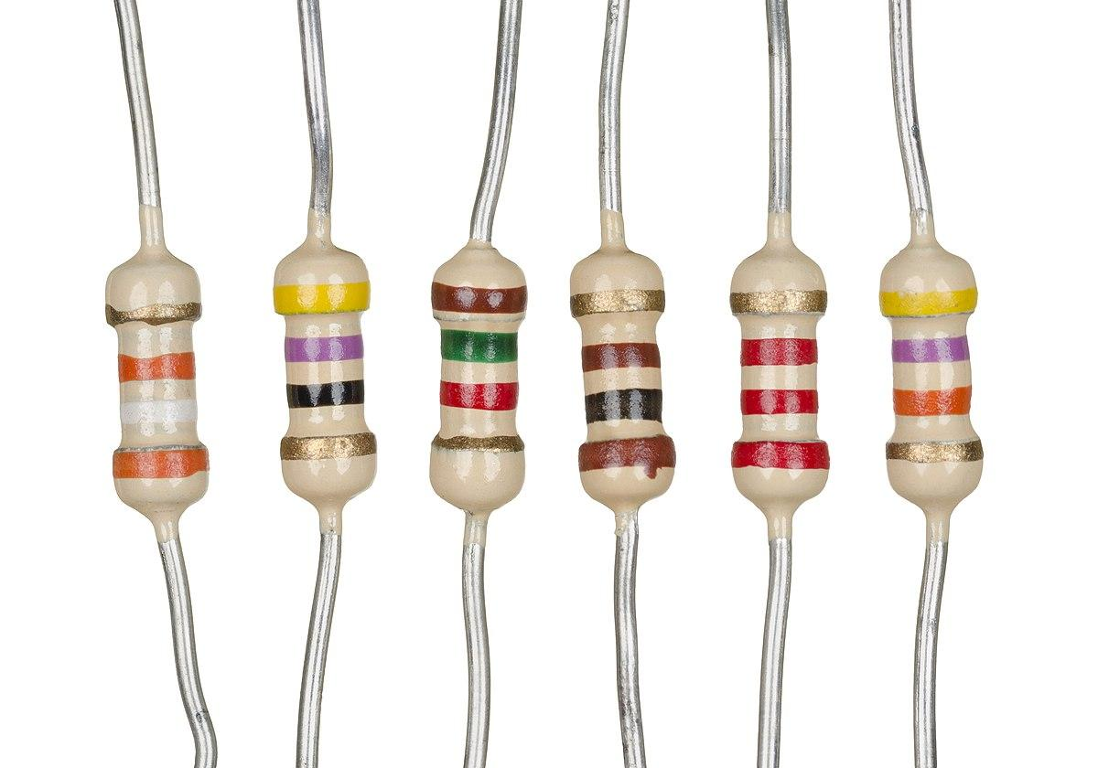
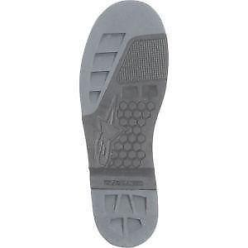
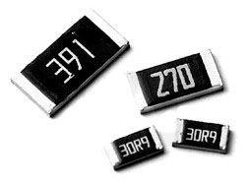
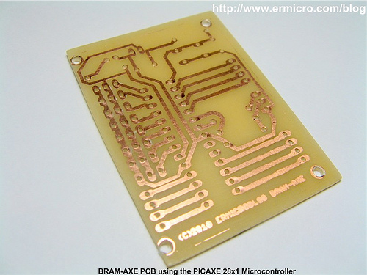
Materials Required
Arduino Feather 32U4 BLE
Lithium Battery - 3.3 V
Force Sensing Units x 4
4 Surface Mount Resistors
4 LED + 270 Ohm Resistors x 4
Resistor (3.6 KOhm) x 4
Shoe Outline for sole
Bluetooth Module HC-05
Printed Circuit Boards
Programming Language
Bread Board for Testing
Notes:
Presenter-Frita

Slide 4
Process
Step 1
Step 2
Step 3
Step 4
Step 5
Designing the PCB board for the bluetooth module using EAGLE
Milling
Writing a code that would read the sensor output for each sensor
Uploading it to the feather board
Connected the bluetooth module with the feather board
Sensor data outputs were read using the USB connection
Wireless bluetooth connection to read the sensor outputs.
Plotting the sensor output
Filtering the noise from the sensor signals
Recorded the sensor output and calculated MFP for each profile.
Notes:
Presenter-Frita

Slide 5


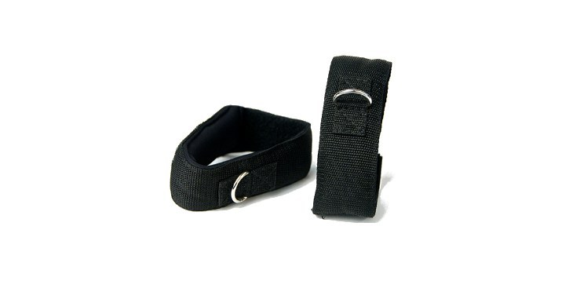
What our device looks like?
Components:
2 printed PCBs
Arduino Feather 32U4 BLE
Feather
4 Force Sensors
4 LED + 270 Ohm Resistors x 4
Resistor (3.6 KOhm) x 4
Perf Board
Accelerometer
Shoe sole with force pads
Strap
Box
3.3 Volt Battery
Data Analysis:
3 point weighted symmetrical filter
Had to separate the data and store in arrays
Python and Arduino used
Device Wear:
Attach the device using the strap provided around the lower part of the leg near ankle.
Insert sole into your shoe and place the foot over the same.
Notes:
Presenter-Luke
Picture of device and where foot sensors go , device specifications etc , how would one attach the device.

Slide 6
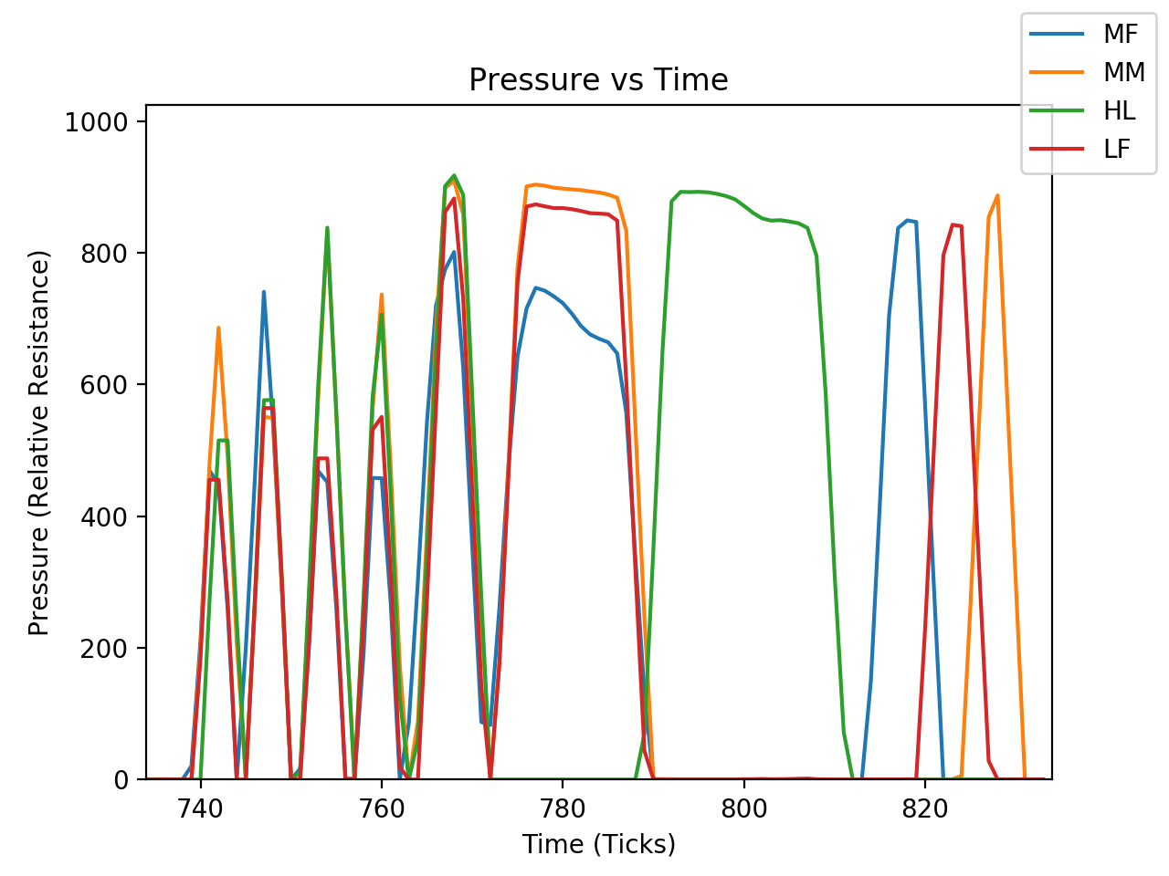
Foot Profile Graph when someone is walking
Notes:
Presenter-Luke

Slide 7
Calculations
Step Length: 18 in
Stride Length: 44 in
Cadence: 200 millisecond delay(0.2s per tick) - 8 ticks(1.6s) - 60s/1.6-37.5 steps/minute
Speed : 18 in/12 in * 37.5 steps/minute = 56.25 ft/minute
Step Count: Variable
Notes:
Presenter-Luke
1) Step length 2) Stride length 3) Cadence 4) Speed 5) Step Count - And display it ?

Slide 8
5 profiles of user walking

Slide 9
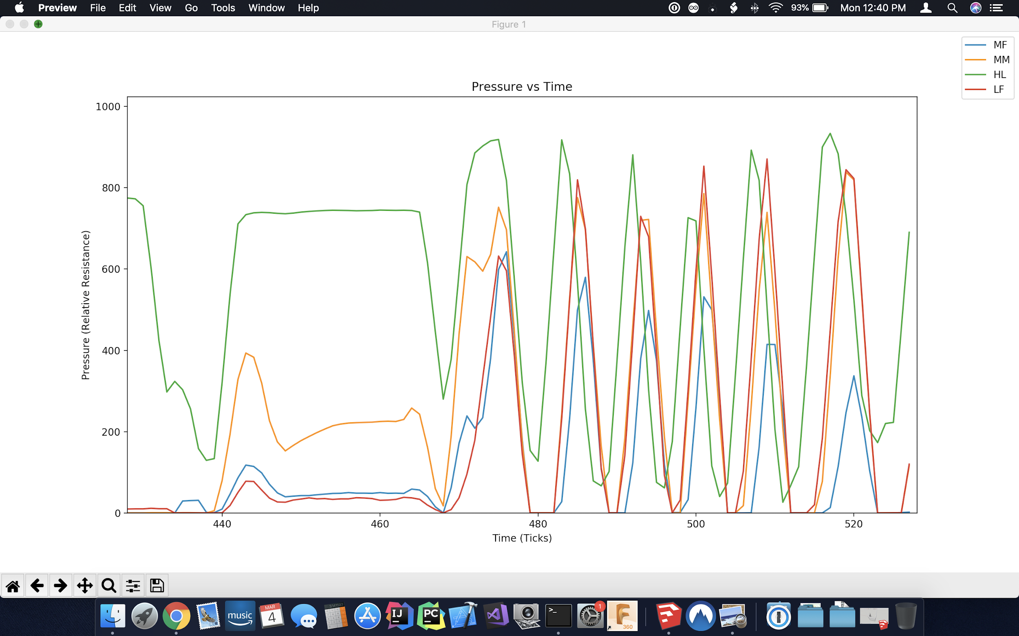
Normal Gait
FEET ARE STRAIGHT AND PARALLEL IN THIS GAIT.
MFP = 41.13%
Notes:
Presenter-Michael
Show MFP Calculation and the graph , 41.13

Slide 10
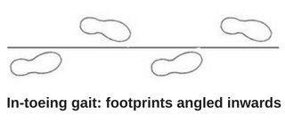
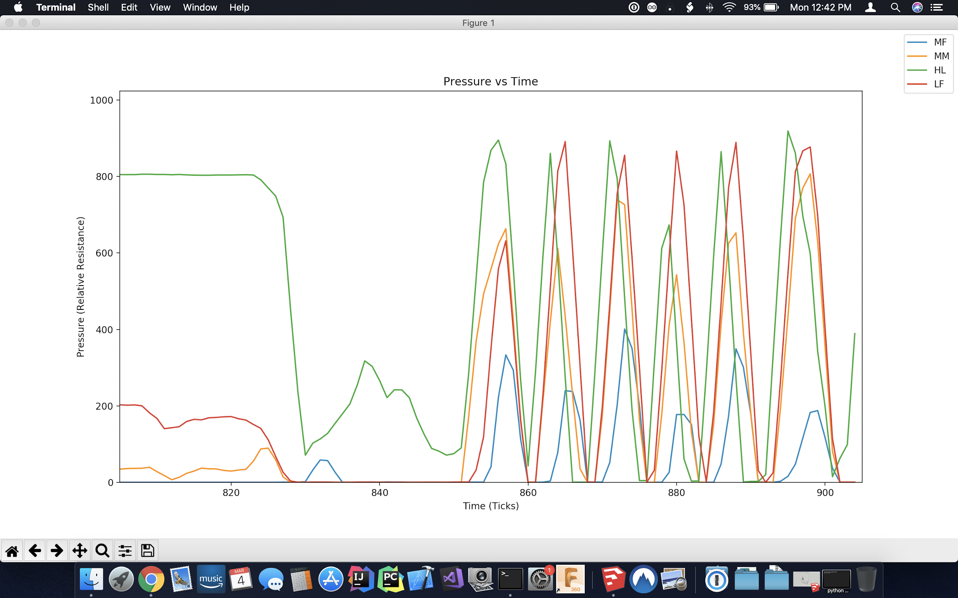
In-toeing
MFP = 29.80%
Notes:
Presenter-Michael
Show MFP Calculation and the graph , 29.80%

Slide 11
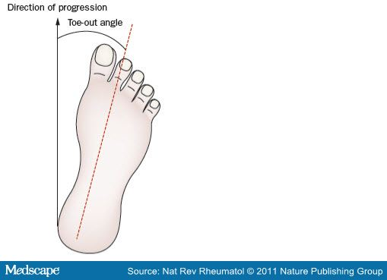
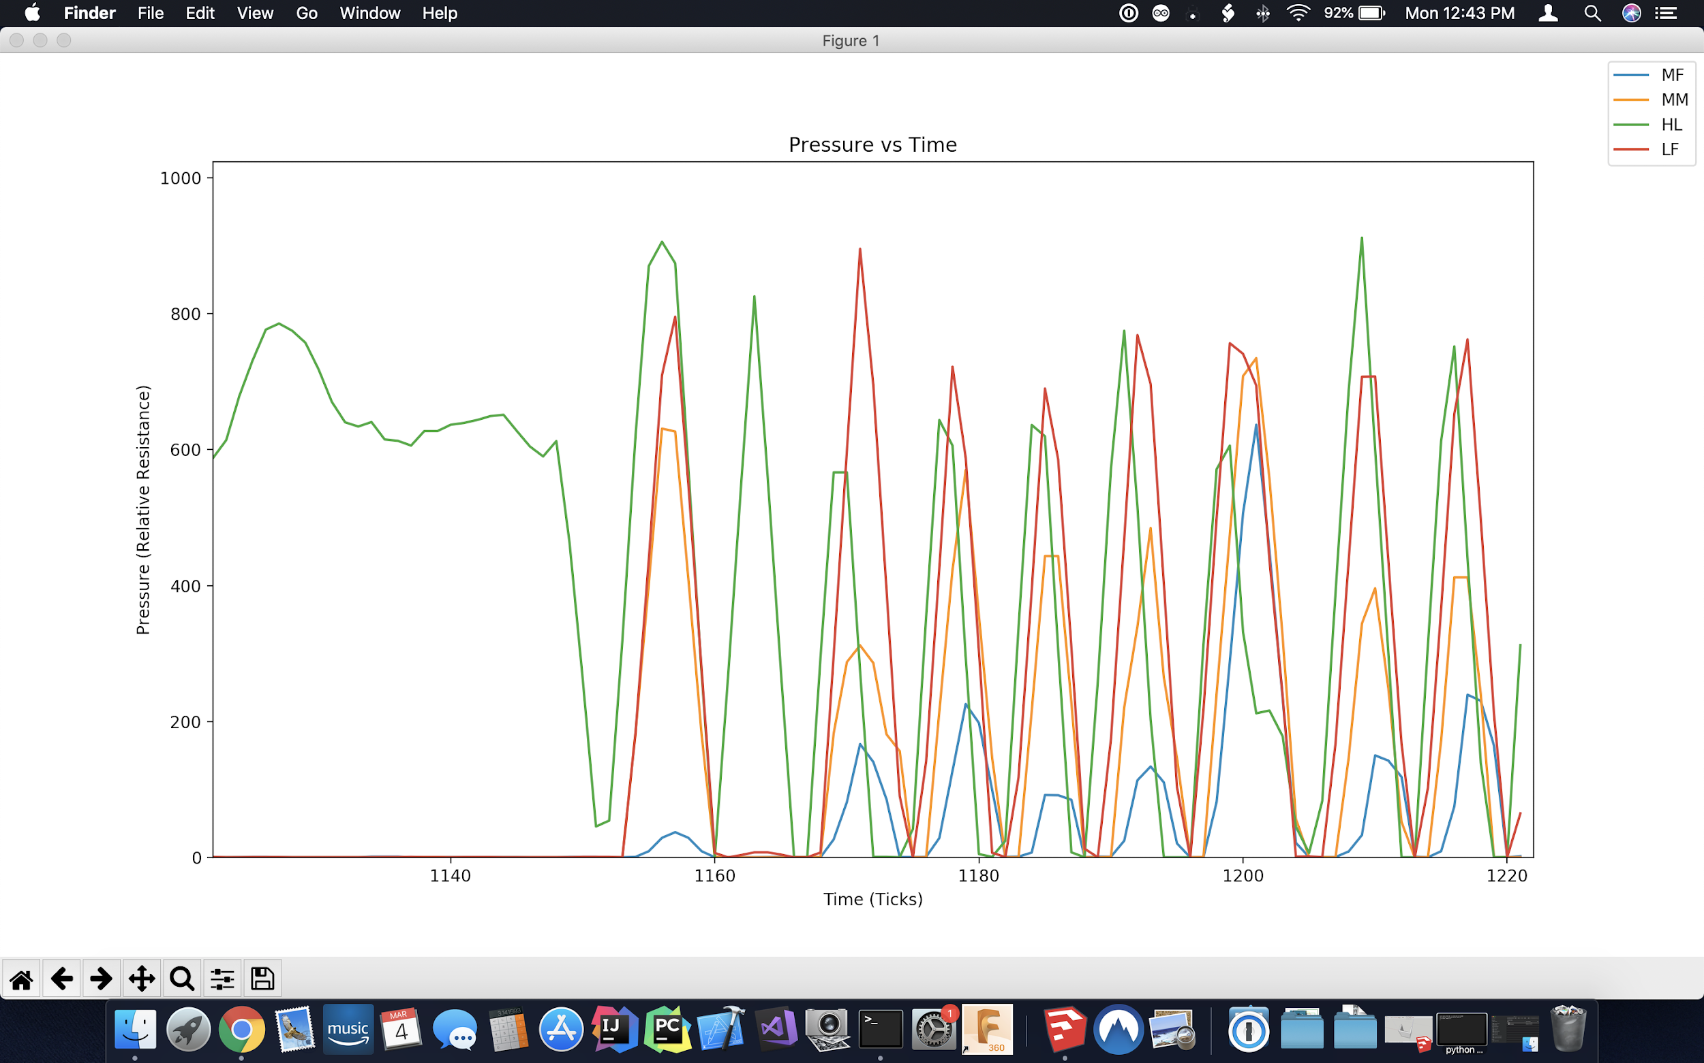
Out-toeing
MFP = 31.37%
Notes:
Presenter-Michael
Show MFP Calculation and the graph , 31.37%

Slide 12
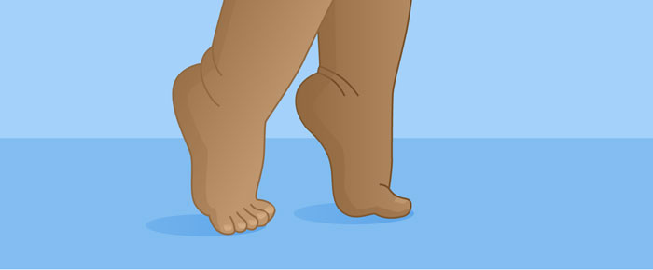
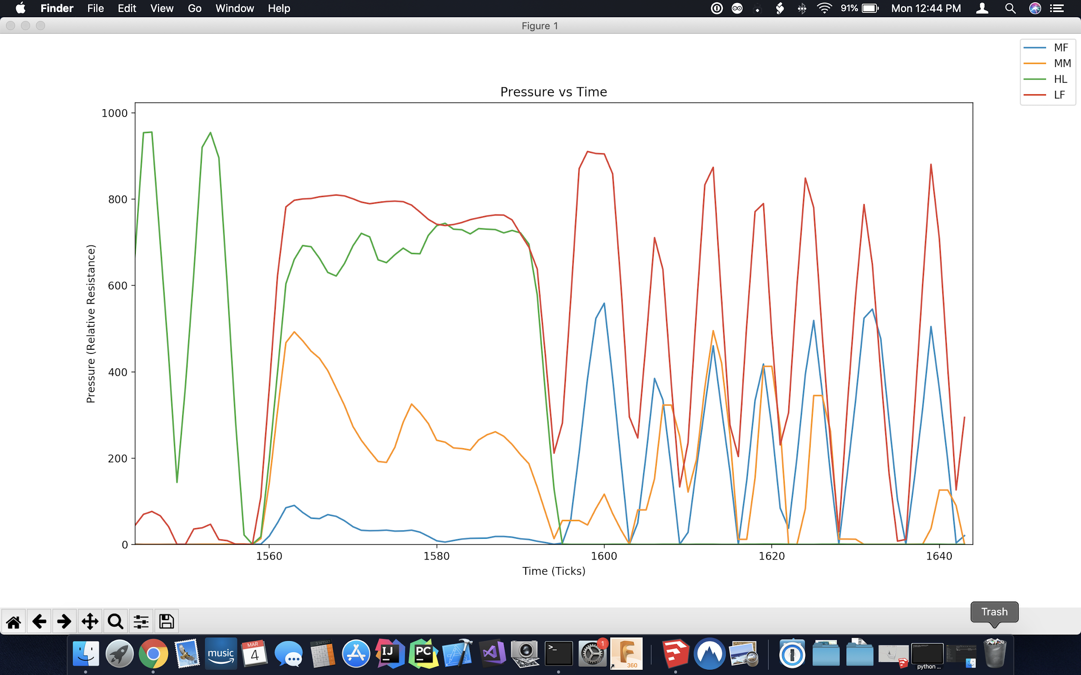
Tip-toeing
MFP = 49.36%
Notes:
presenter-Michael
Show MFP Calculation and the graph

Slide 13
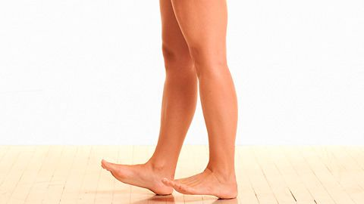
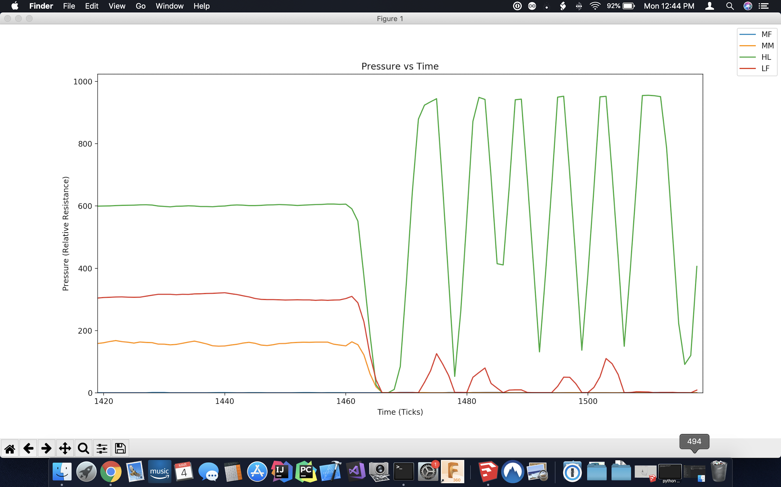
Walking on Heel
MFP = 0%
Notes:
Presenter-Anu
Show MFP Calculation and the graph

Slide 14

Challenges we faced as a group
Our bluetooth module was broken so we spent a week and a half trying to understand why the bluetooth module was not connecting to our laptop. We had to use a new bluetooth module altogether.
The pin we used for bluetooth was the same pin we were writing to so when we tried to upload our code , all we would get was arbitrary symbols as in no data. Once we changed the pin , we were able to get data .
Notes:
Presenter-Anu

Slide 15
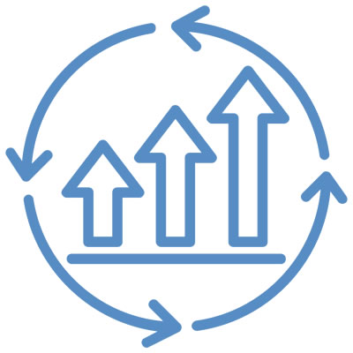
Potential Improvements
We can get more accurate data if we use more force sensors to account for pressure from left and right sides of the heel or toe area.
Make the device lighter so it is more convenient to wear.
Improve on comfort - the sole of the shoe and ankle strap/box used to attach/cover the device can be altered
This is very personalized, aim for a general product to make into a marketable product.
Notes:
Presenter-Anu

Slide 16
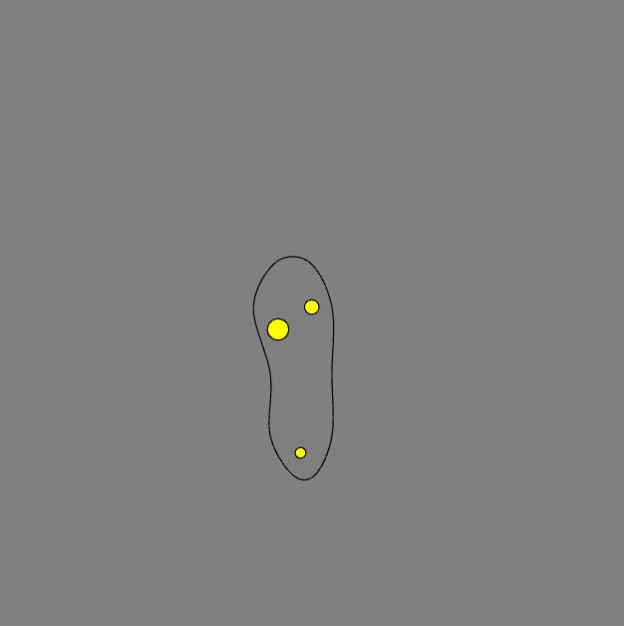
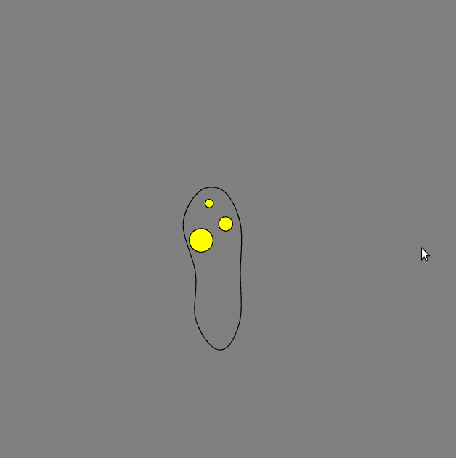
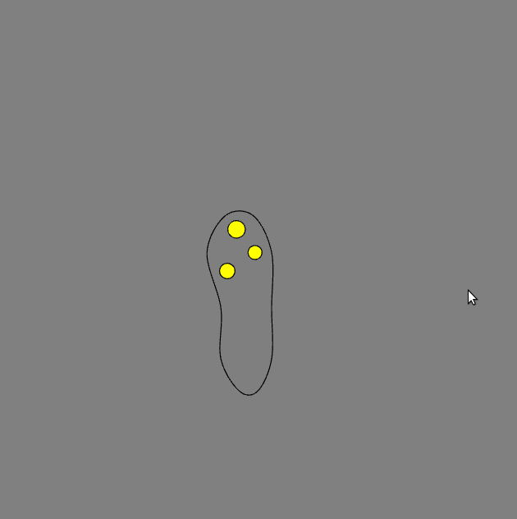

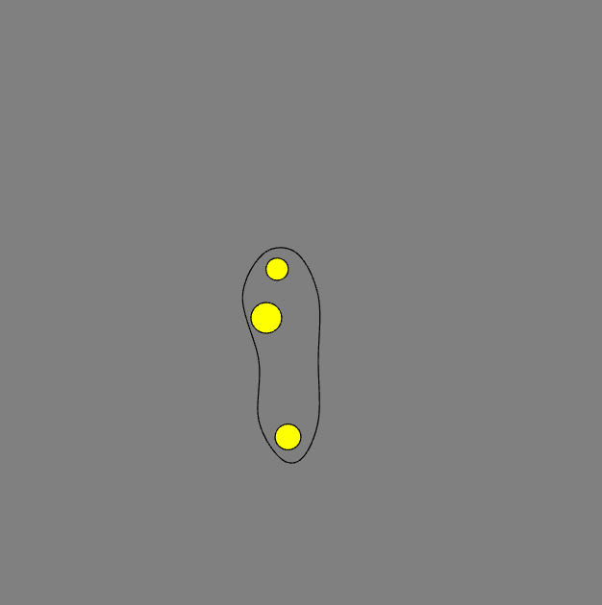
Pressure Visualization →
Notes:
Luke → do live demo

Slide 17
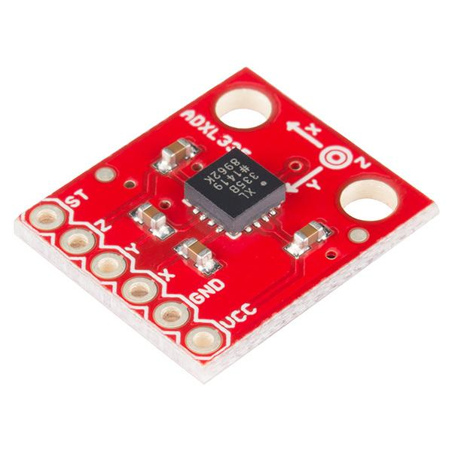
Accelerometer
We were able to attach the accelerometer and obtain data from it but were unable to analyze it due to time constraints.
Option to expand
Implemented basic gyro info (i.e. x&y plane) into Pressure Visualization program → feature removed
Notes:
Presenter-Anu Collects data , we don’t analyze it

Slide 18
Sources for Images
https://www.medbridgeeducation.com/blog/2016/03/why-toe-walking-is-not-idiopathic/
https://skillsforaction.com/pigeon-toes-femoral-anteversion
http://jacjackie4308.blogspot.com/2014/11/ronald-demon-ceo-of-vectrasense-tech.html
https://www.medscape.org/viewarticle/736532_3
https://www.sparkfun.com/products/9269
https://www.sparkfun.com/products/13854
https://www.amazon.com/LeaningTech-HC-05-Module-Pass-Through-Communication/dp/B00INWZRNC
https://www.adafruit.com/product/2829?gclid=EAIaIQobChMI0J2GlIDq4AIVtR6tBh0-oAt4EAQYASABEgJoQvD_BwE
https://tinkersphere.com/sensors/1256-fsr-force-sensor-pressure-sensor-arduino-compatible.html
https://www.lifewire.com/what-does-led-stand-for-4153820
https://en.wikipedia.org/wiki/Resistor
https://www.instructables.com/id/Reading-Surface-Mount-Resistor-codes/
https://www.ebay.com/bhp/shoe-soles
http://www.ermicro.com/blog/?p=1526
https://www.runnersworld.com/video/a20844364/safe-keepers-heel-walking-toe-raises/
https://www.robsonforensic.com/articles/gait-analysis-expert-witness/
https://www.arduino.cc/en/Trademark/HomePage
https://www.python.org/
https://www.superflexfitness.com/shop/ankle-straps/
https://hackernoon.com/13-major-challenges-faced-while-building-a-community-experts-roundup-e3a59aa28fbf
https://www.processexcellencenetwork.com/innovation/articles/continuous-improvement-4-factors-that-make-a-conti
Ovidsp.tx.ovid.com. (2019). Ovid: External Link. [online] Available at:

Slide 19
THANK YOU!

